Slide 1
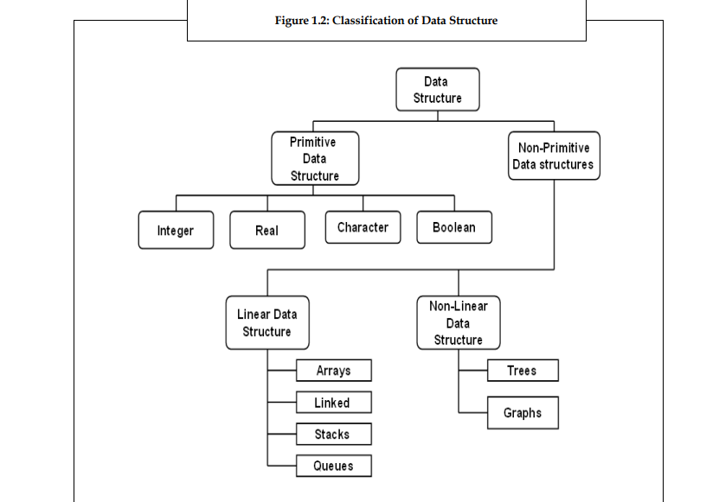
DATA STRUCTURE

Slide 2
NEED OF DATA STRUCTURE
Data structure modification is easy.
It requires less time.
Save storage memory space.
Data representation is easy.
Easy access to the large database.

Slide 3
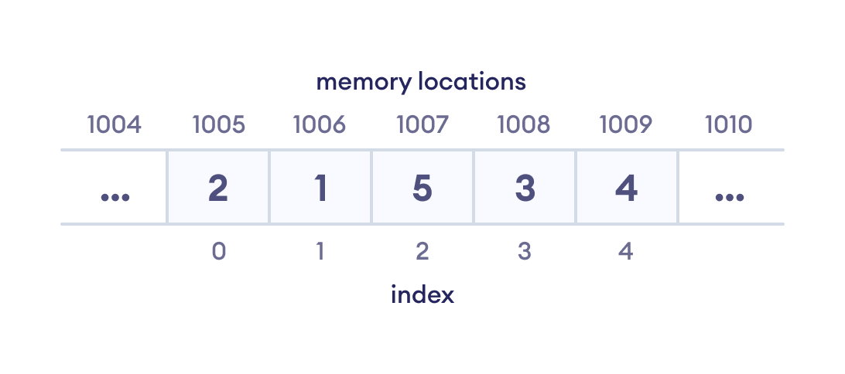

Slide 4
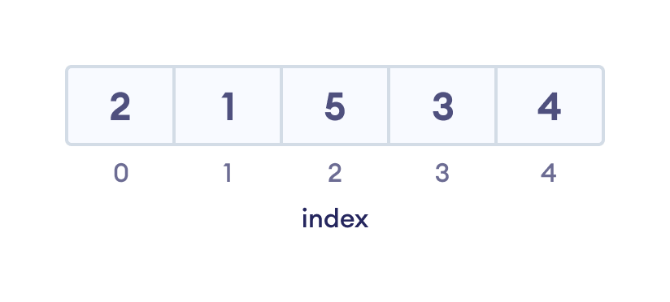
1. Array Data Structure
In an array, elements in memory are arranged in continuous memory.
All the elements of an array are of the same type.
And, the type of elements that can be stored in the form of arrays is determined by the programming language.

Slide 5
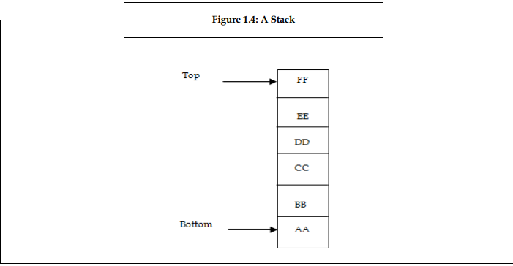
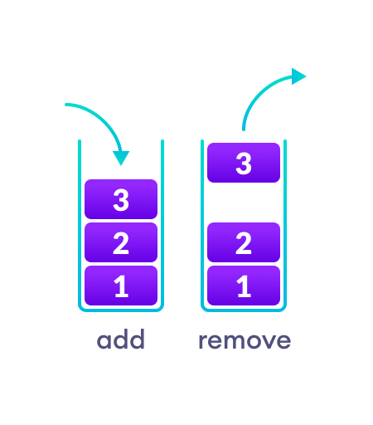
2. Stack Data Structure
In stack data structure, elements are stored in the LIFO principle. That is, the last element stored in a stack will be removed first.
It works just like a pile of plates where the last plate kept on the pile will be removed first.
Figure – 1
Figure - 2

Slide 6
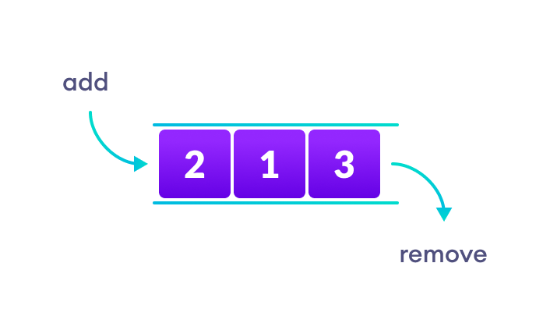
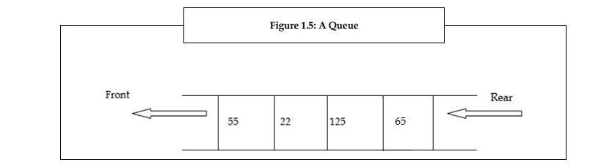
3. Queue Data Structure
Unlike stack, the queue data structure works in the FIFO principle where first element stored in the queue will be removed first.
Ex : It works just like a queue of people in the ticket counter where first person on the queue will get the ticket first.
Figure – 3
Figure - 4

Slide 7
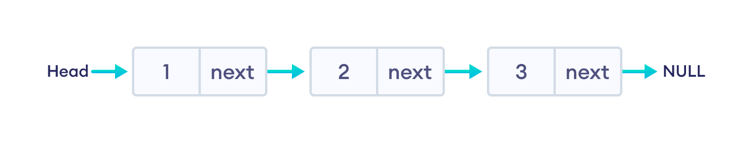
4. Linked List
A linked list is a data structure in which each data element contains a pointer or link to the next element in the list.
Through linked list, insertion and deletion of the data element is possible at all places of a linear list. Also in linked list, it is not necessary to have the data elements stored in consecutive locations.
It allocates space for each data item in its own block of memory. Thus, a linked list is considered as a chain of data elements or records called nodes.
Each node in the list contains information field and a pointer field. The information field contains the actual data and the pointer field contains address of the subsequent nodes in the list

Slide 8
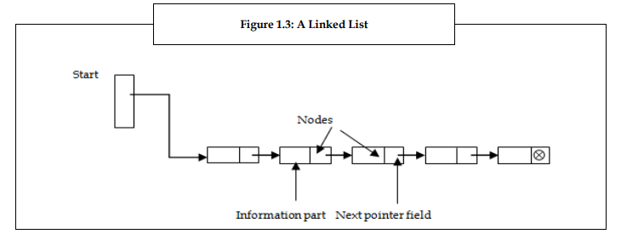
It represents a linked list with 4 nodes.
Each node has two parts. The left part in the node represents the information part which contains an entire record of data items and the right part represents the pointer to the next node.
The pointer of the last node contains a null pointer
Figure - 5

Slide 9
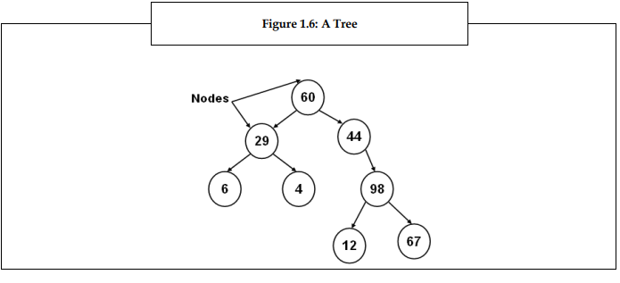
Trees
A tree is a non-linear data structure in which data is organized in branches. The data elements in tree are arranged in a sorted order.
It imposes a hierarchical structure on the data elements. It represents a tree which consists of 8 nodes. The root of the tree is the node 60 at the top. Node 29 and 44 are the successors of the node 60.
The nodes 6, 4, 12 and 67 are the terminal nodes as they do not have any successors.

Slide 10
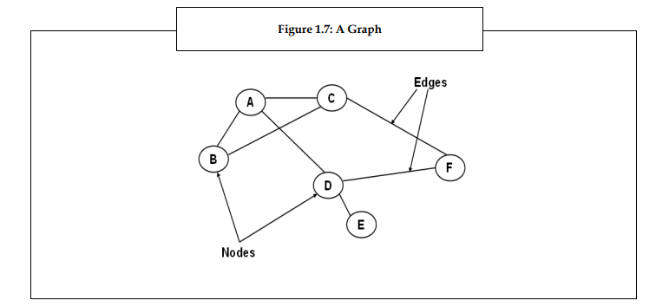
Graphs
Graphs A graph is also a non-linear data structure. In a tree data structure, all data elements are stored in definite hierarchical structure.
In other words, each node has only one parent node. While in graphs, each data element is called a vertex and is connected to many other vertexes through connections called edges.
Thus, a graph is considered as a mathematical structure, which is composed of a set of vertexes and a set of edges. It shows a graph with six nodes A, B, C, D, E, F and seven edges [A, B], [A, C], [A, D], [B, C], [C, F], [D, F] and [D, E].

Slide 11
LINEAR ARRAY / 1-D ARRAY
Definition : A linear or one-dimensional array is a structured collection of elements (often called array elements). It can be accessed individually by specifying the position of each element by an index value.
Ex : A linear array can be anything from a row of trees or a street full of lampposts. Any sequence with repeated objects or shapes forms a linear array.
ArrayName[IndexExpression] The IndexExpression must be an integer value. The integer value can be of char, short int, long int, or Boolean value because these are integral data types. The simplest form of index expression is a constant.
If we consider an array number[25],
then, number[0] specifies the 1st component of the array
Number[1] specifies the 2nd component of the array.
Number[2] specifies the 3rd component of the array
number[3] specifies the 4th component of the array.
Number[4] specifies the 5th component of the array . . .
.
.
Number[24] specifies the last component of the array

Slide 12
LINEAR ARRAY / 1-D ARRAY
To store and print values from the number array, we can perform the following:
for(int i=0; i < 25; i++) { number[i]=i; // Storing a number in each array element
printf("%d", number[i]); //Printing the value
}
To store values in a number array we use a for loop.
For every iteration of the for loop, the value of i is assigned to each element of the array and then the values are printed using a printf statement.
Each element of an array is treated as a simple variable. Each array element is declared to hold a value of integer data type
Ex : for(int i=0; i < 25; i++)
{ //Iterations
/* Double the value in each array element and store it in the array element*/
number[i]=2*number[i];
printf(“The output of Linear array is = %d”, number[i]);
}

Slide 13
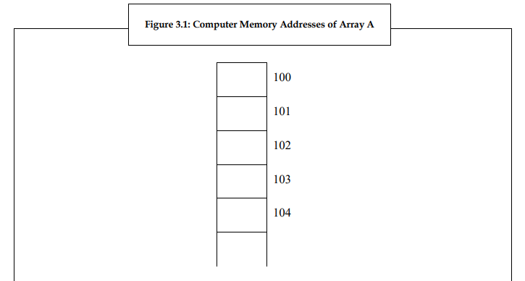
REPRESENTATION OF LINEAR ARRAY IN MEMORY
LOC (A[P]) = address of the element A[P] of the array A.
LOC (A[P]) = Base (A) + w (P – lower bound)

Slide 14
CALCULATING THE ADDRESS OF ARRAY ELEMENT
Here, A is a linear array, w is the size of each element of the array A, LOC is a variable used to store the
location of the linear array, and P is the index of the element. The time required to calculate LOC (A[P])
is fundamentally the same for any value of P. Suppose the array A has the capacity to store 4 elements.
The size of the array elements is as shown below:
A[0] = 2 bytes
A[1] = 2 bytes
A[2] = 2 bytes
A[3] = 2 bytes
Hence, the memory occupied by Array A is 8 bytes

Slide 15
NUMERICAL PROBLEMS
Consider an array A having a base address of 100, so Base(A)= 100. Let us now calculate the address of A[1]. Here, index of the element is, P=1, size of each integer, w=2 and lower bound is 0. The formula is: LOC (A[P]) = Base (A) + w (P – lower bound) Therefore, LOC (A[1] = 100 + 2(1-0) = 102
2. Base Address (B) = 101
LB = 0, UB = 9
Size / Width of each element W = 2 bytes
K is at position 5
Find the address of an element with index K.

Slide 16
NUMERICAL PROBLEM ANALYSIS
Ans 1. The formula is: LOC (A[P]) = Base (A) + w (P – lower bound) Therefore, LOC (A[1] = 100 + 2(1-0) = 102
Ans 2. Address of an element with index K :
Loc (A[K]) = B + W (K – LB )
= 101 + 2 * ( 5 – 0 )
= 111
So address of A [5] = 111

Slide 17
CALCULATING THE LENGTH OF AN ARRAY
The length of an array is given by the number of elements stored in it.
The general formula to calculate the length of an array is Length = Upper bound – Lower bound + 1
Where upper bound is the index of the last element and lower bound is the index of the first element in the array.
Problem – 3 : Let Age [5] be an array of integers such that Age[0] =2, Age[1] = 5, Age [2] = 3, Age [3] =1, Age[4] = 7. Show the memory representation of the array and calculate its length.
Solution :
Age [0] Age [1] Age [2] Age [3] Age [4]
Length = Upper bound – Lower bound + 1
Hence, lower bound = 0, upper bound = 4
Therefore , length = 4 – 0 + 1 = 5
2 | 5 | 3 | 1 | 7

Slide 18
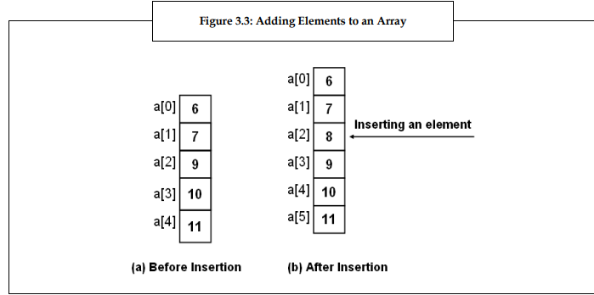
INSERTION IN ARRAY

Slide 19
Algorithm for Array insertion
Step 1 : [ INITIALIZATION ] SET I = N
Step 2 : Repeat steps 3 and 4 while I > = POS
Step 3 : SET A [I + 1 ] = A [ I ]
Step 4 : SET I = I – 1
[ End of loop ]
Step 5 : SET N = N + 1
Step 6 : SET A [ POS ] = VAL
Step 7 : EXIT

Slide 20
Another Way of Array insertion algorithm
Algorithm for Inserting an Element into an Array Let a be an array of size N and I be the array index. Algorithm to insert an element in the Mth
1. Start position of the array a is as follows:
2. read a[N], I<-0
3. repeat for I=N to M (Decrement I by one)
4. a[I+1]<- a[I]
5. a[M]<-ELEMENT
6. M<-M+1
7. Stop

